Slide 1
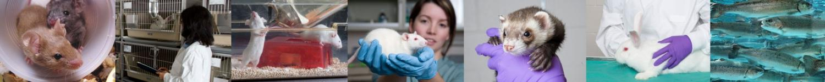
CCAC Training Module on: laboratory animals used in BIOMEDICAL Research
www.ccac.ca

Slide 2
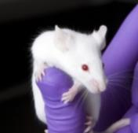
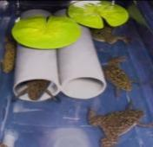
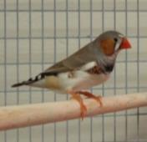
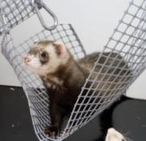
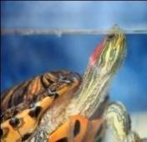
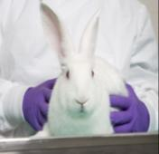
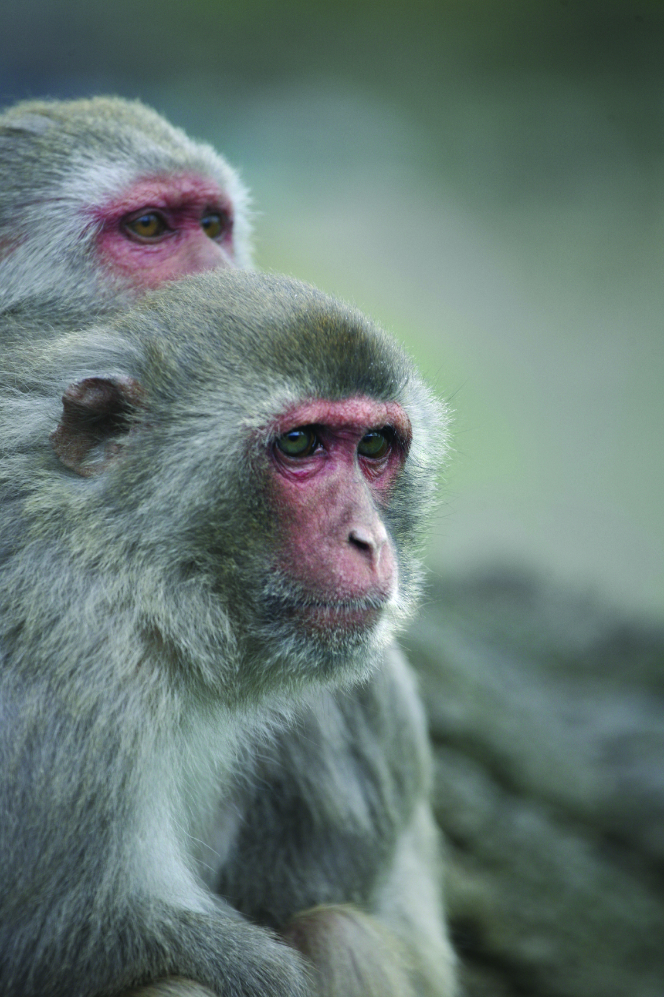
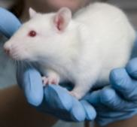
Relevance of this Training Module
This training module is relevant to all animal users working with animals housed in vivaria (enclosed areas such as laboratories) in biomedical research
This training module covers the following animals housed in vivaria:
rodents
rabbits
birds
amphibians
reptiles
non-human primates
other mammals
Photo courtesy of Dr. S.Craig
2

Slide 3
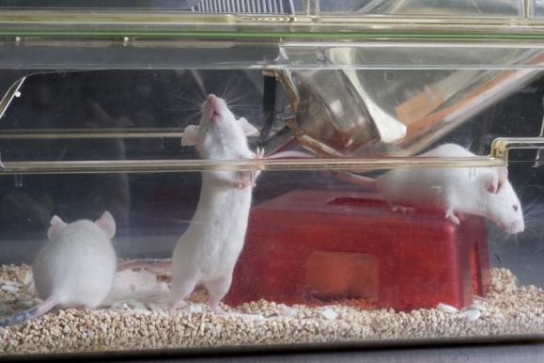
Training Module Goals
Understand the differences in the types of animal models used in biomedical research and the importance of their selection
Recognize the importance of accounting for and controlling the variables in the experimental design
Develop a checklist of the variables that can affect research programs
Describe and accept responsibility for ensuring the successful conduct of an experiment
3

Slide 4
Training Module Outline
Use and selection of animal models in biomedical research
Variables influencing the response of an animal model to an experiment:
animal related factors
physical and environmental factors
husbandry, animal care and handling factors
experimental manipulation factors
Responsibilities of team members involved with a research project:
principal investigator
graduate students, post-doctoral students and research technicians
facility manager
animal care staff
laboratory animal veterinary staff
4

Slide 5
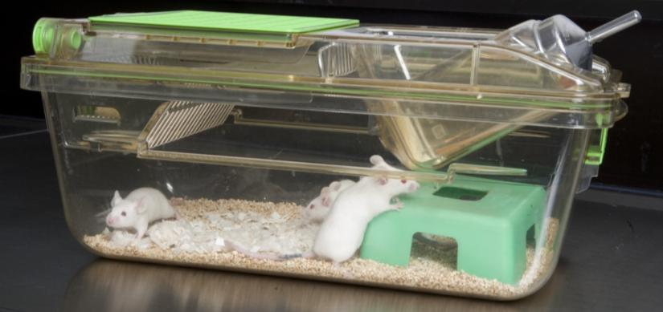
Animal Models Used in Biomedical Research
Animal models are used in biomedical research to study:
biology
behaviour
spontaneous or induced pathological processes
phenomenon that resembles those in humans
5

Slide 6
Types of Animal Models Used in Biomedical Research
1. Spontaneous or “natural” models
naturally occurring animal disease/condition that corresponds to the same disease/condition in humans
(ie., diabetes, arthritis)
2. Experimental models
disease/condition is reproduced by the investigator
(ie., cancer, stroke)
6

Slide 7
Types of Animal Models Used in Biomedical Research
3. Genetically-engineered models
manipulation of animal’s genetic code to produce the disease/condition
4. Negative models
animals that are resistant to a particular disease/condition
5. Orphan models
animal disease/condition for which there is no known human counterpart
7

Slide 8
Choosing an Appropriate Animal Model
REPLACEMENT
Consideration of
non-animal alternatives or animals with lower sentience
Before an animal model is chosen, investigators must consider alternatives to the use of live animals (Three Rs)
REDUCTION
Using appropriate animal models and numbers to minimize
variation and
number of
animals required
REFINEMENT
modification of
husbandry or
experimental
procedures to
minimize pain and distress, and enhance animal welfare
Investigators must consider all factors when selecting the best model for research
See the CCAC training module on: the Three Rs of humane animal experimentation (2003) and visit the CCAC Three Rs microsite at www.ccac.ca/en/alternatives for further information on this topic
8

Slide 9
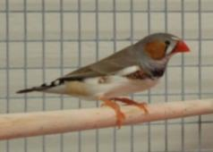
Factors that Influence Animal Research
Husbandry, Animal Care & Handling Factors
Research Manipulation Factors
Animal Stress
Time and Duration of Manipulation
Physical & EnvironmentalFactors
Room
Temperature
Bedding
Animal RelatedFactors
Transportation Stress
Age, Sex, Reproductive Status
Disease
Experimental Stressors
Relative
Humidity
Feed and
Water
Genetic
Make-up
Photo courtesy of Dr. S.Craig
Microbial
Flora
BiologicalRhythms
Housing Stress
Ventilation
Noise
Pain
Lighting
9

Slide 10
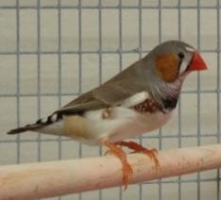
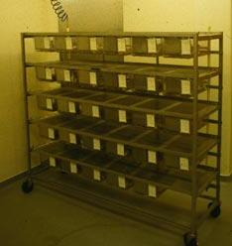
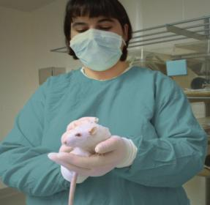
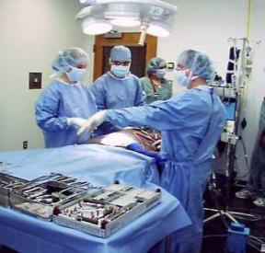
Non-Experimental Factors that Influence Animal Research
The non-experimental factors that can influence the response of the animal model (and affect the outcome of the study) can be grouped as:
animal related factors
physical and environmental factors
husbandry, animal care and handling factors
research manipulation factors
Photo courtesy of Dr. S.Craig
10

Slide 11
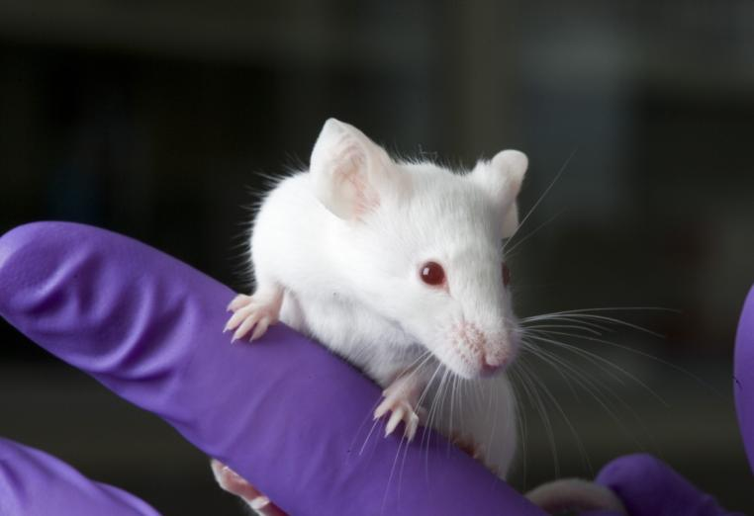
Animal Related Factors
11

Slide 12
Animal Related Factors
1. Age, sex and reproductive status
responses vary with age and gender of animal
hormone and physiological variations can also influence responses of females and males
2. Genetic make-up
inbred (genetically identical) vs. outbred
genetic manipulation can affect phenotype
12

Slide 13
Animal Related Factors
3. Microbial flora
most animals carry microbes that can be a source of variability in research
4. Biological (circadian) rhythms
metabolism varies with time of day
ie., rodent metabolic rates are higher at night
they can cause drugs to have variable effects depending on time of day they are administered
important to perform manipulations at the same time of day for all animals
13

Slide 14
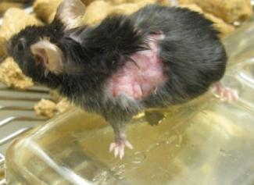
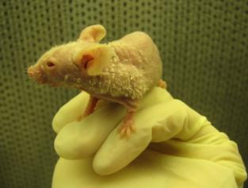
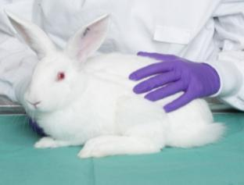
Animal Related Factors
5. Disease
Clinical disease:
disease is apparent in the animal
Subclinical disease:
animal appears healthy despite presence of infectious organisms
Photo courtesy of Dr. J. Gourdon
Photo courtesy of Dr. J. Gourdon
Fur mite infestation in a mouse
Immune deficient or immune compromised models are very susceptible to ordinarily non-pathogenic organisms
How can you be sure that this rabbit is not harbouring a virus, bacteria or parasite that will interfere with your research results?
See the CCAC training module on: infectious diseases (2010) for further information
on this topic
14

Slide 15
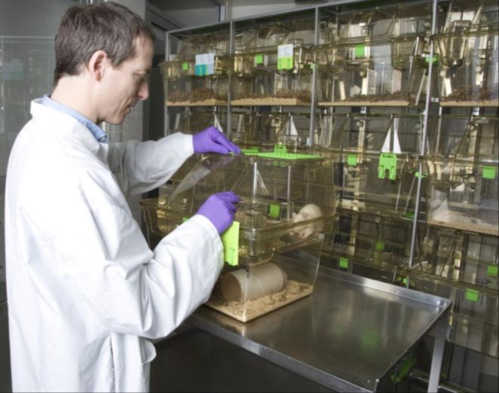
Physical & Environmental Factors
See Chapter III – The Environment, Guide to the Care and use of Experimental Animals Vol. 1 (2nd Ed.) 1993 for further information on this topic
15

Slide 16
Physical & Environmental Factors
1. Room temperature
temperature variations can cause changes in:
behaviour (huddling, shivering)
metabolic rate (higher food consumption for body heat production)
temperature fluctuations should be:
monitored
limited to +/- 2ºC as these changes can affect metabolic processes including drug metabolism
16

Slide 17
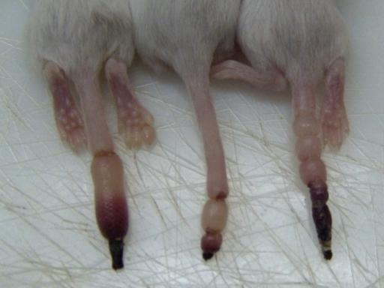
Physical & Environmental Factors
2. Relative humidity (RH)
RH can affect :
thermoregulation
food consumption
activity level
disease transmission
most species do well with RH levels between 40 and 60%
level should be appropriate for species and kept consistent (+/- 5%)
Prolonged low levels of RH can cause ringtail in young, unweaned rats and result in respiratory irritation
17

Slide 18
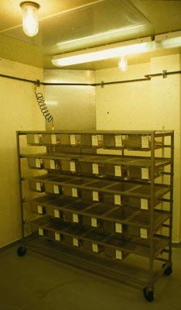
Physical & Environmental Factors
3. Ventilation
animal housing requires high air exchange rates to remove heat, ammonia, carbon dioxide and airborne particles
4. Lighting
day/night cycle
consistent diurnal rhythms are necessary
intensity of lights
light intensities of greater than 300 lux
can cause retinal damage to albino rodents
wavelength
influences organ weights and estrus cycle
length in mice
18

Slide 19
Physical & Environmental Factors
5. Noise
May induce seizures in young rodents and can affect:
food and water consumption
reproduction
blood pressure
immune response
white blood cell count
plasma cholesterol levels
learning abilities
19

Slide 20
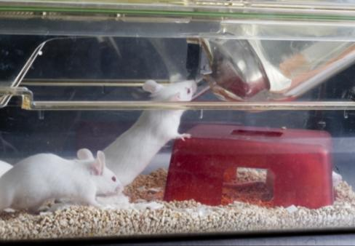
Physical & Environmental Factors
6. Feed and water
animals should be given a consistent and reproducible diet that meets nutritional needs
provided with water to meet the standards set for human consumption
7. Bedding
regular bedding materials should be provided to animals
20

Slide 21
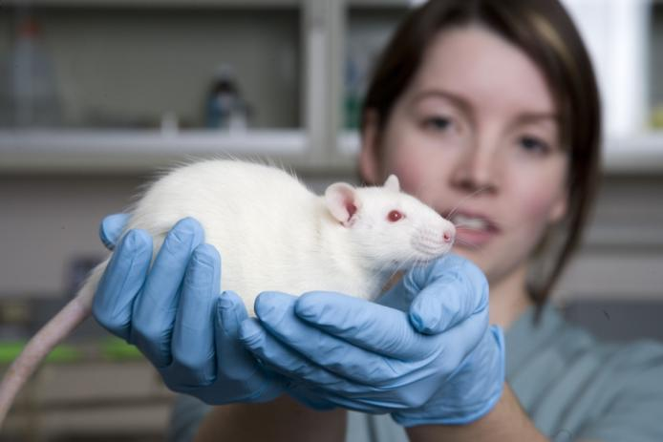
Husbandry, Animal Care & Handling Factors
See Chapter II – Laboratory Animal Facilities, Guide to the Care and use of Experimental Animals Vol. 1 (2nd Ed.) 1993 for further information on this topic
21

Slide 22
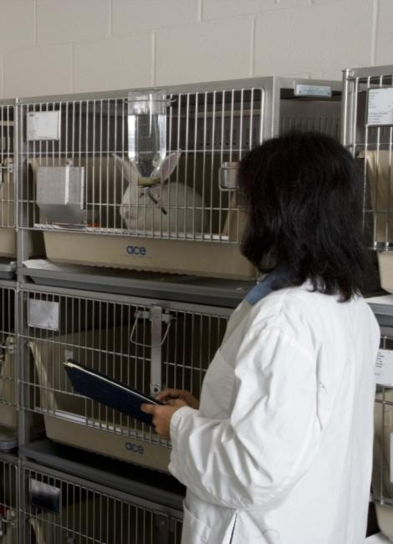
Husbandry, Animal Care & Handling Factors
1. Transportation
animals should be allowed sufficient time to acclimate to the research facility upon arrival
a minimum of one week is recommended
2. Housing
caging
space per animal and number of animals per cage should remain consistent within a study
significant differences in temperature, humidity and air quality, noise and vibration levels between different types of cages
22

Slide 23
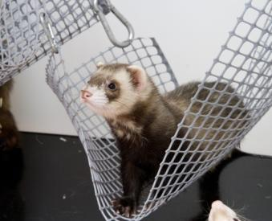
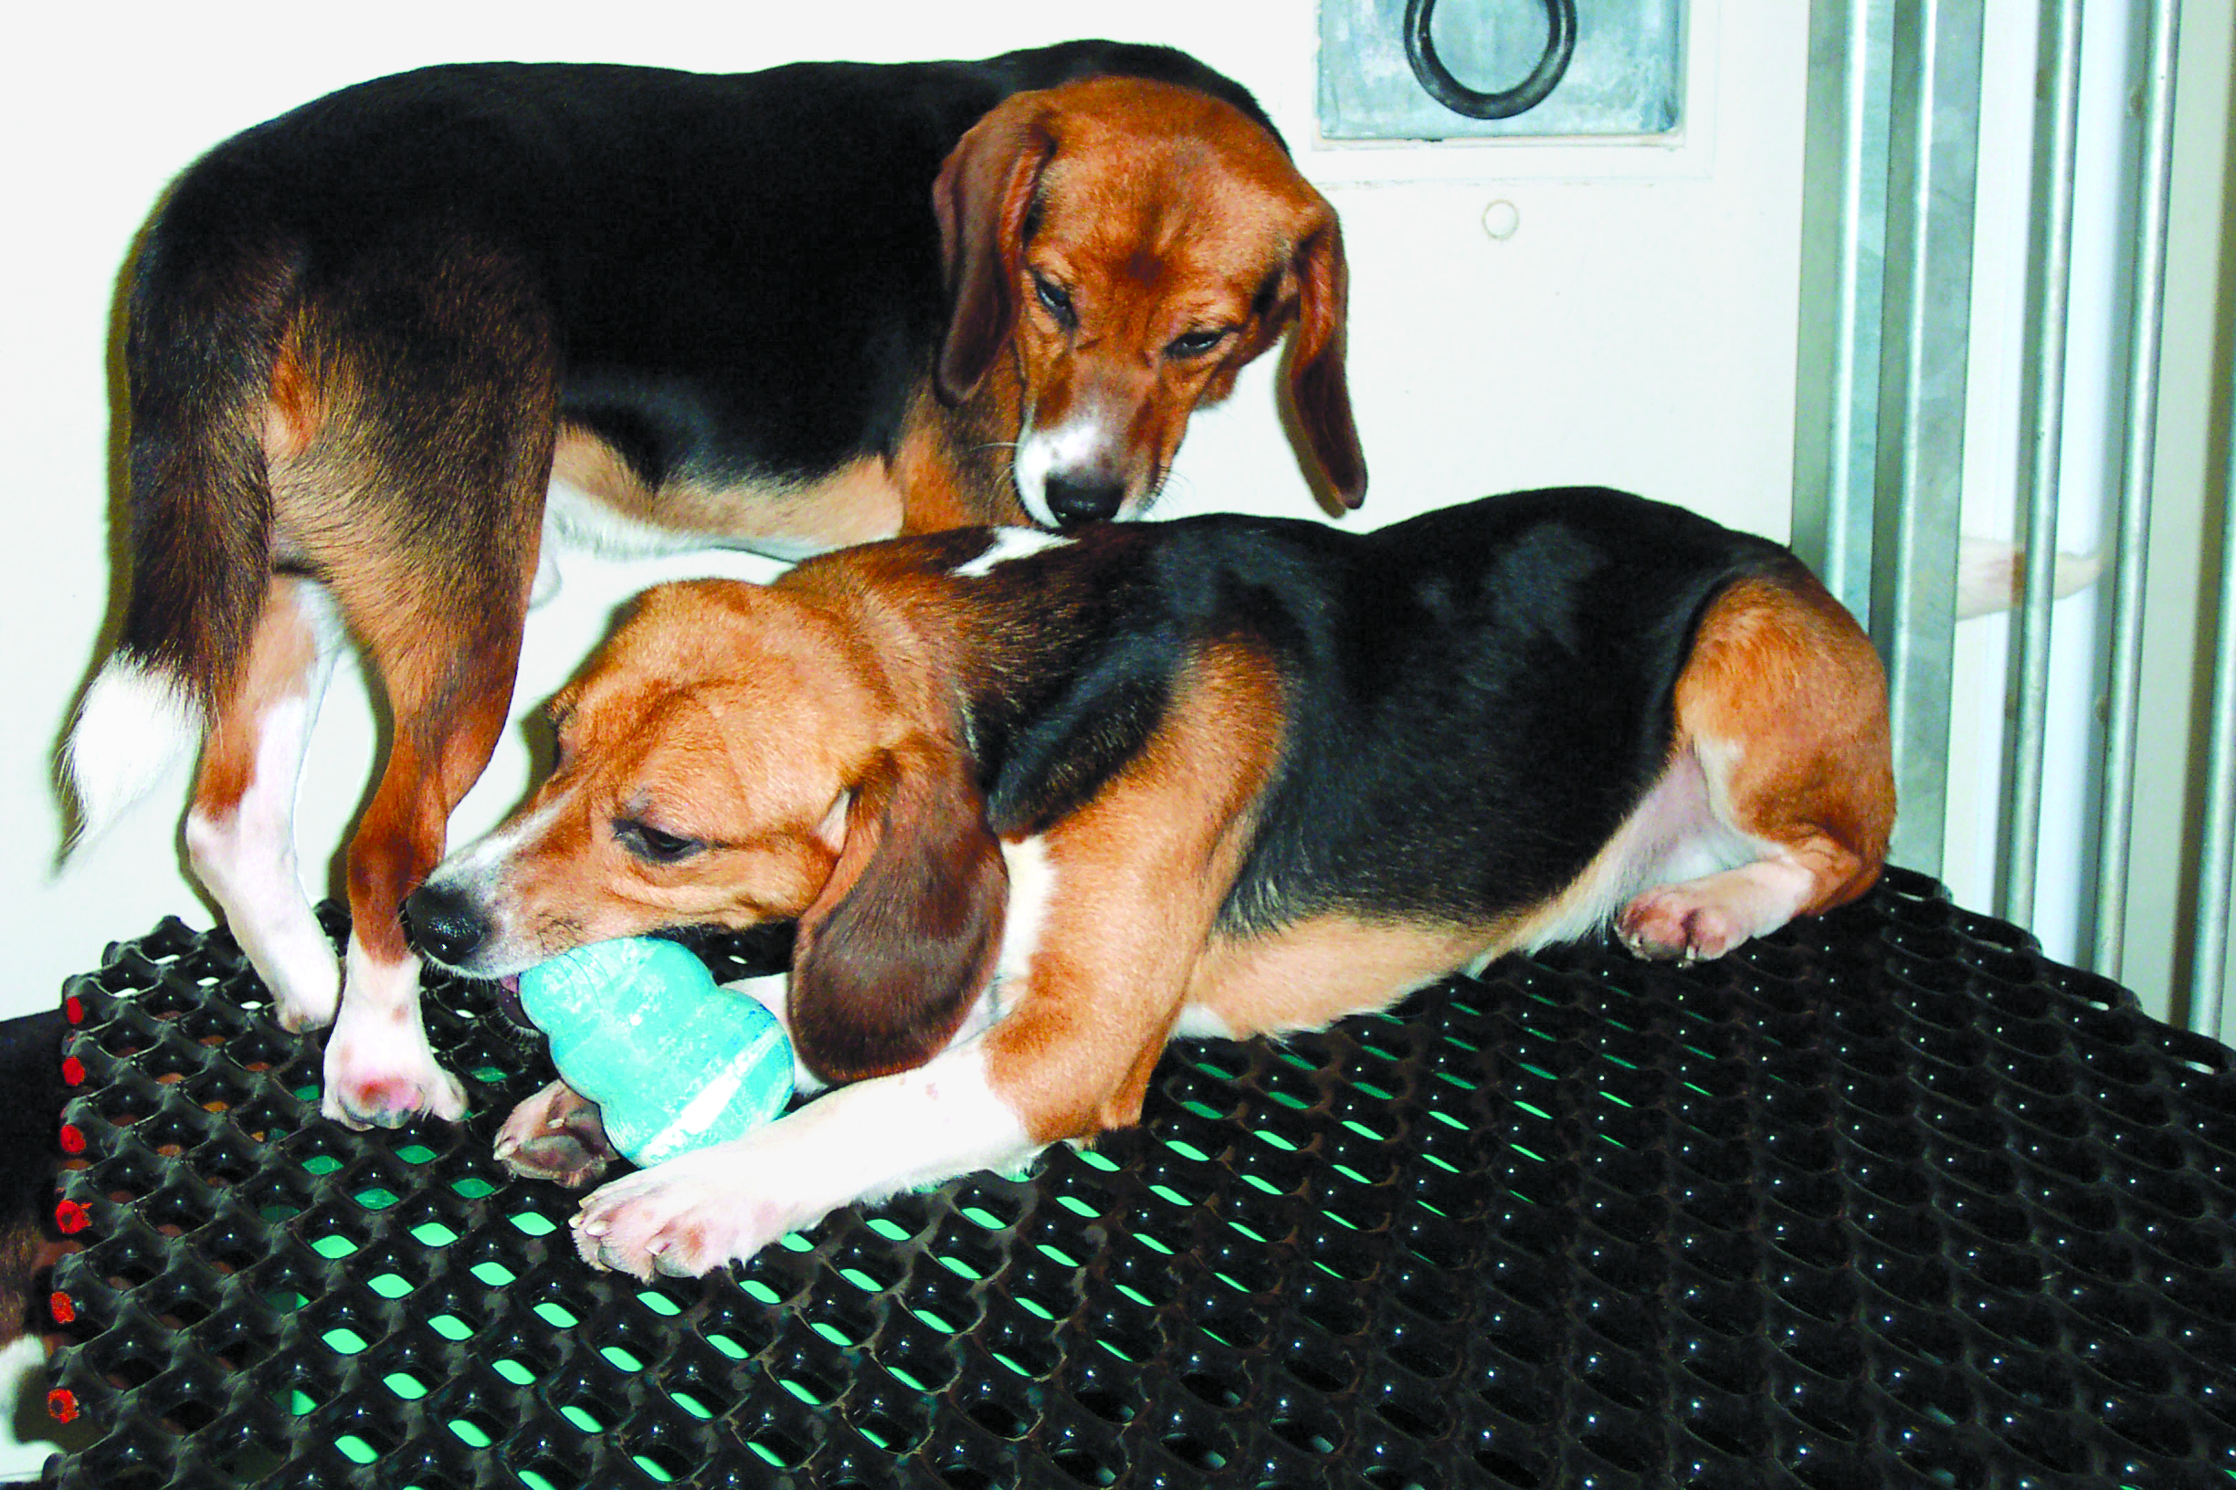
Husbandry, Animal Care & Handling Factors
2. Housing (continued)
environmental enrichment
can improve animal well-being
should be uniformly and consistently provided for the duration of the experiment
Hammocks can be used in cages to make
them more interesting and stimulating to ferrets
Toys and chewable objects allow the expression of species-typical postures and activities
See the CCAC training module on: environmental enrichment (2003) and the
CCAC Three Rs microsite at www.ccac.ca/en/alternatives for further information on this topic
23

Slide 24

Husbandry, Animal Care & Handling Factors
3. Routine care, husbandry and handling
all animals should be handled the same
way at the same time of day
if not possible, randomize design
handling must be gentle and consistent to
minimize variability
the kind of handling an animal receives
may alter behaviour or physiology, thereby
affecting its response in a study
24

Slide 25
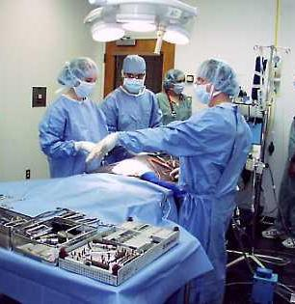
Experimental Manipulation Factors
25

Slide 26
Experimental Manipulation Factors
1. Time and duration of manipulation
efforts should be made to:
take repeated samples as the same time of day everyday
keep duration of manipulation consistent
2. Experimental stressors
familiarizing an animal to manipulation before a project starts is important to reduce stress
It is recommended that Standard Operating Procedures (SOPs) be written & observed to standardize each and every animal manipulation
26

Slide 27
Experimental Manipulation Factors
3. Pain
untreated pain can affect biology and physiology
amount of pain will depend on:
the dose and time of administration of analgesics
handler’s skills
previous experience of animal
the added presence of fear or stress
See the CCAC training module on: pain, distress and endpoints (2010), the CCAC training module on: analgesia (2003), and the CCAC training module on: anesthesia (2003)
for further information on these topics
27

Slide 28
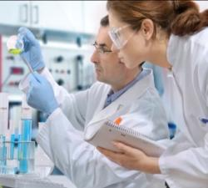
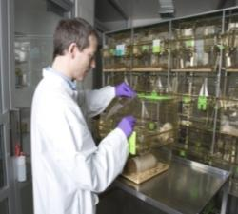
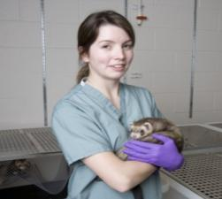
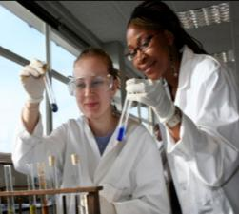
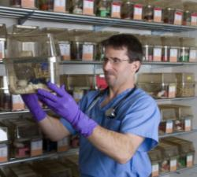
Responsibilities of Research Team Members
All play a role in limiting the effects of both
non-experimental and experimental variables
28

Slide 29
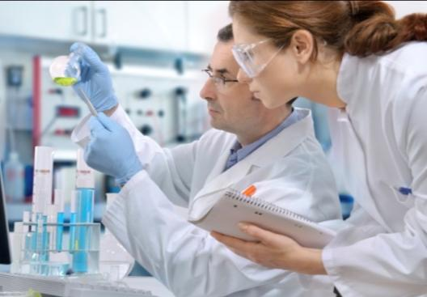
Principal Investigator
Considers and outlines all pertinent variables
Consults and observes SOPs to:
ensure that all experimental variables
are controlled
ensure monitoring/recording of controls of variables
limit disease introduction
Ensures animal health quality before, and regular health monitoring after purchase
29

Slide 30
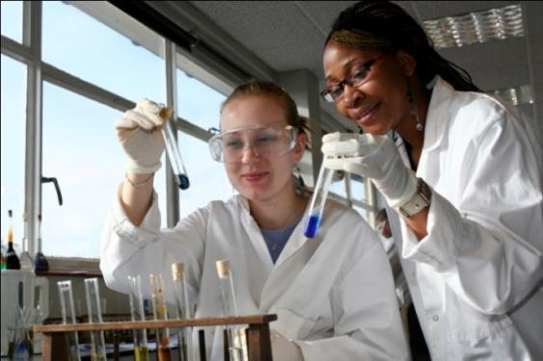
Graduate Students, Post-Doctoral Students and Research Technical Staff
Monitor and record controls on all variables
Employ skilled animal handling and manipulation techniques
Consult and observe SOPs to:
limit disease introduction
conduct all experimental procedures accordingly
30

Slide 31
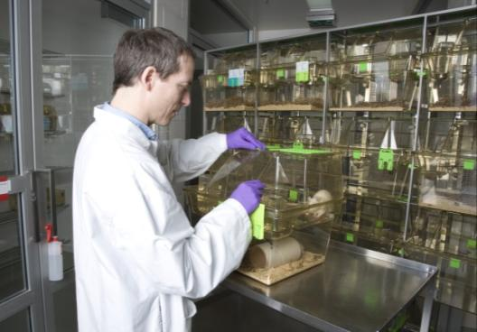
Facility Manager
Ensure consistent facility environmental operations
Ensure high level of animal care training and expertise
Implement SOPs for all animal facility operations
Ensure animal health before purchase and health monitoring after
31

Slide 32
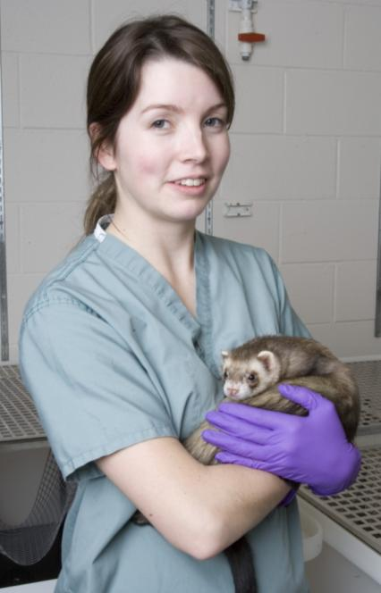
Animal Care Facility Staff
Conduct daily animal facility routines according to SOPs
Conduct all animal care handling and manipulations in a way that is:
consistent
gentle
humane
32

Slide 33

Laboratory Animal Veterinary Staff
Advise on and ensure health status of all animals
Effect procedures that will maintain animal health quality
33

Slide 34
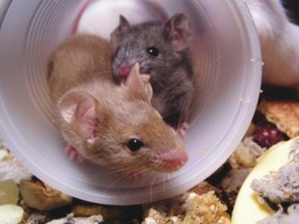
Summary
Animal models must be carefully selected with the Three Rs in mind
Animals are influenced by the many different factors that can affect experimental results:
animal related factors
physical factors
husbandry/handling factors
experimental manipulation factors
All members of the research and animal care teams have a role to play in recognizing and controlling these variables
Quality Animal Care = Quality Science
34

